Slide 1
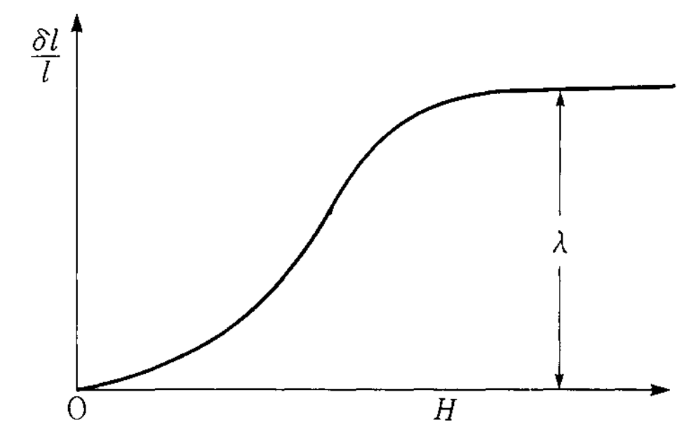
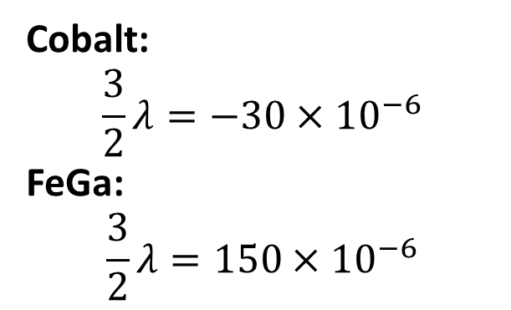
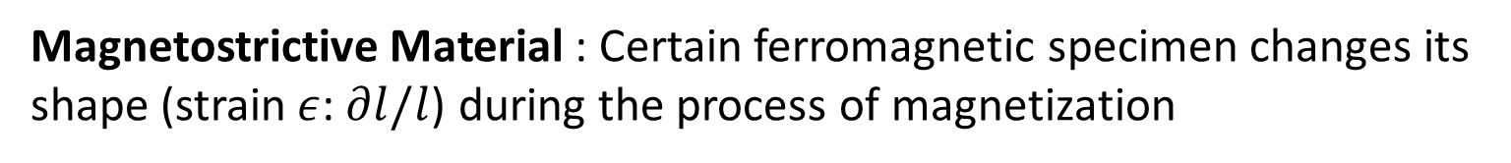
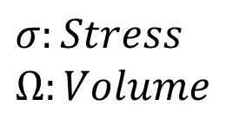
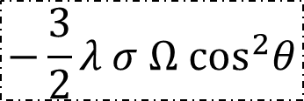

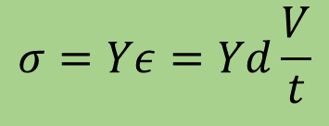
Magnetostriction
Magnetostrictive Material : Certain ferromagnetic specimen changes its shape (strain$ε$:$∂l/l$) during the process of magnetization
Magnetostrictive Anisotropy ↔ Stress Anisotropy
$$−\frac{3}{2}λ σ Ω \cos^{2}θ$$
$λ:$ Magnetostriction Co-efficient
$$σ:Stress$$
$$Ω:Volume$$
Cobalt:
$$\frac{3}{2}λ=−30×{10}^{−6}$$
FeGa:
$$\frac{3}{2}λ=150×{10}^{−6}$$
$$σ=Yε=Yd\frac{V}{t}$$
Notes:
40KT =1eV=1.610-19J

Slide 2
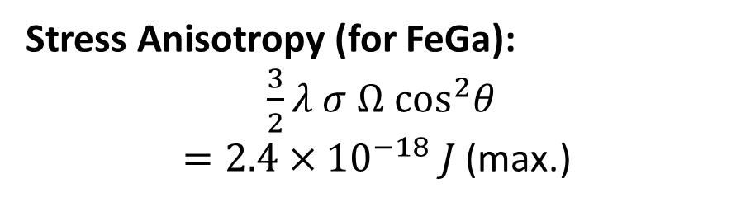
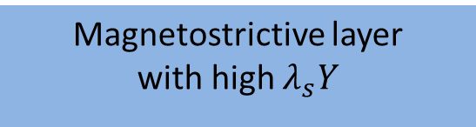
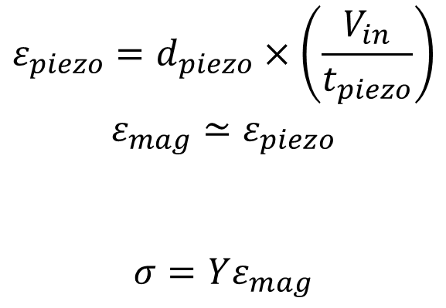
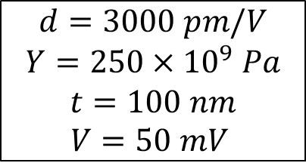
Multiferroic composites Voltage vs stress anisotropy
V_{in}
$$ε_{piezo}=d_{piezo}×\left(\frac{V_{in}}{t_{piezo}}\right)$$
$$ε_{mag}≃ε_{piezo}$$
$$σ=Yε_{mag}$$
Magnetostrictive
Piezoelectric
t_{piezo}
strain transfer
Choose piezoelectric layer with high de-coefficient
Y: Young’s modulus
Magnetostrictive layer
with high $λ_{s}Y$
Stress Anisotropy (for FeGa):
$\frac{3}{2}λ σ Ω \cos^{2}θ$
$=2.4×{10}^{−18} J$ (max.)
$$d=3000 pm/V$$
$$Y=250×{10}^{9} Pa$$
$$t=100 nm$$
$$V=50 mV$$

